Slide 1
Researching and Writing about Educational Activism and Dissent from Inside Academia
Dr Cassie Earl

Slide 2
Context of the research work
Post Seattle New Social Movements
Post-2007/08 crash social movements and the pedagogical turn
The political became more pedagogical – can the pedagogical become more political?
What links social struggles with education?

Slide 3
Some social struggles within Academia
Feminist studies professor (Sara Ahmed) resigns from London's Goldsmiths university over alleged sexual harassment of students by staff
The Law Professor (Patricia Leary) Who Answered Back:
When students complained about a Black Lives Matter shirt, she responded in a letter now going viral
Manchester Metropolitan: 'Bullying' university bans world-renowned professor (Ian Parker) who spoke out
Hundreds of academics, including Noam Chomsky, join campaign against university

Slide 4
Publish and perish at Imperial College London: the death of Stefan Grimm
December 1st, 2014 ·
This week’s Times Higher Education carried a report of the death, at age 51, of Professor Stefan Grimm: Imperial College London to ‘review procedures’ after death of academic. He was professor of toxicology in the Faculty of Medicine at Imperial.
Now Stefan Grimm is dead. Despite having a good publication record, he failed to do sufficiently expensive research, so he was fired (or at least threatened with being fired).
“Speaking to Times Higher Education on condition of anonymity, two academics who knew Professor Grimm, who was 51, said that he had complained of being placed under undue pressure by the university in the months leading up to his death, and that he had been placed on performance review.”

Slide 5
We are not immune to struggle because we reside in the ‘ivory tower’
And nor are our students…………

Slide 6
“since the birth of university, acts of student resistance and rebellion have had profound impacts on the political structures and the histories of many countries; today, student actions continue to have direct effects on educational institutions and on national and international politics” (Edelman Boren, 2001: 3)

Slide 7
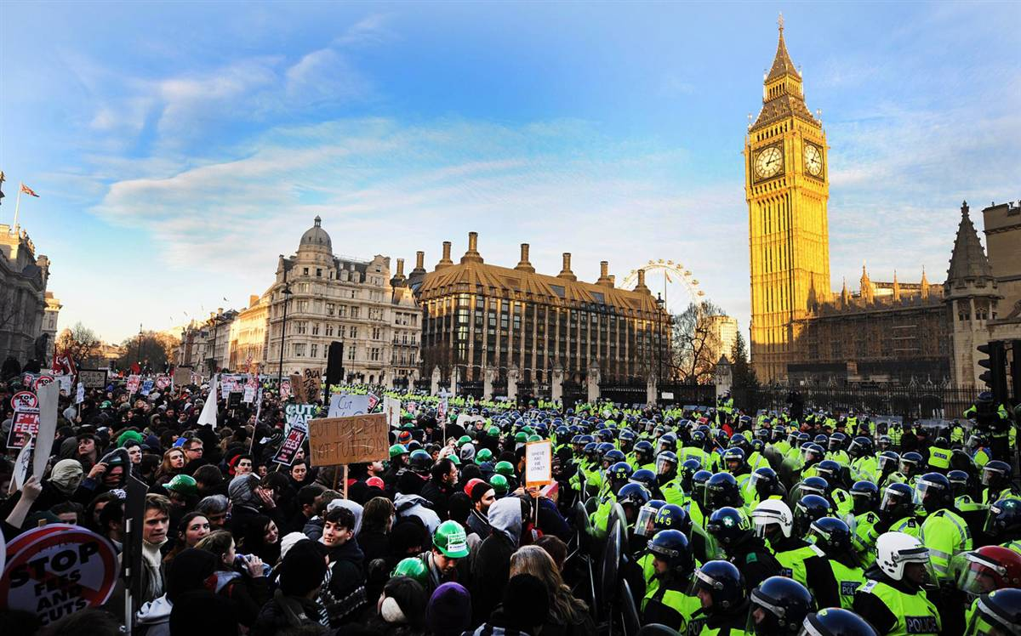

Slide 8
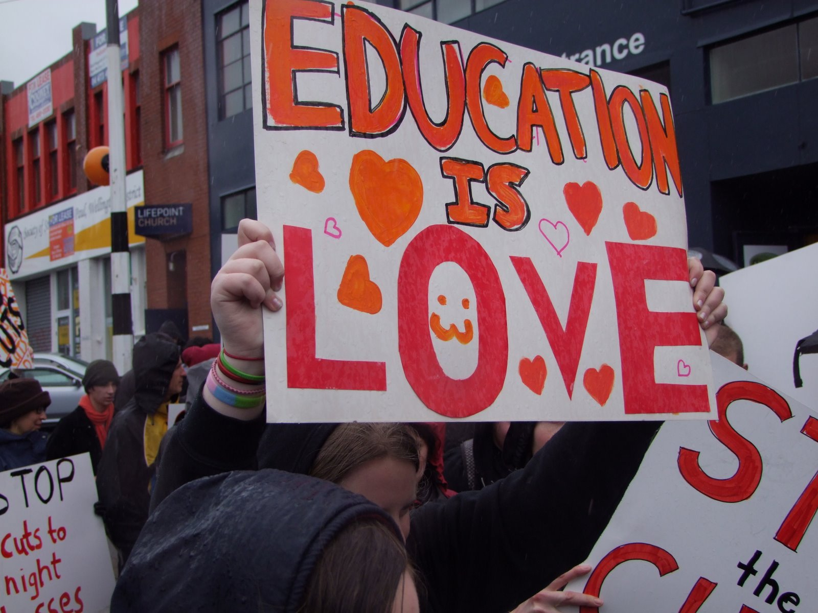

Slide 9
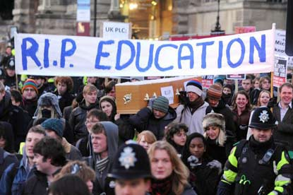

Slide 10
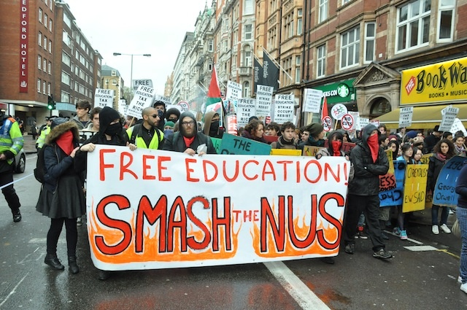

Slide 11
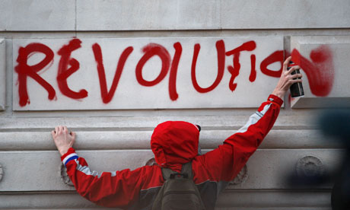

Slide 12
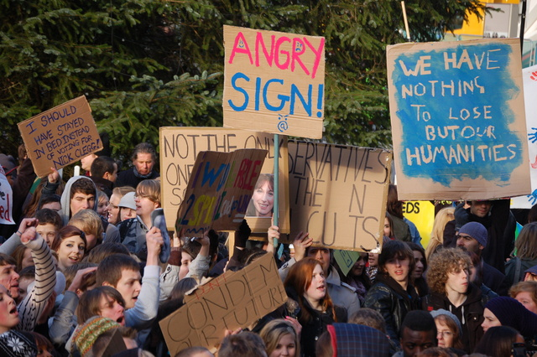

Slide 13
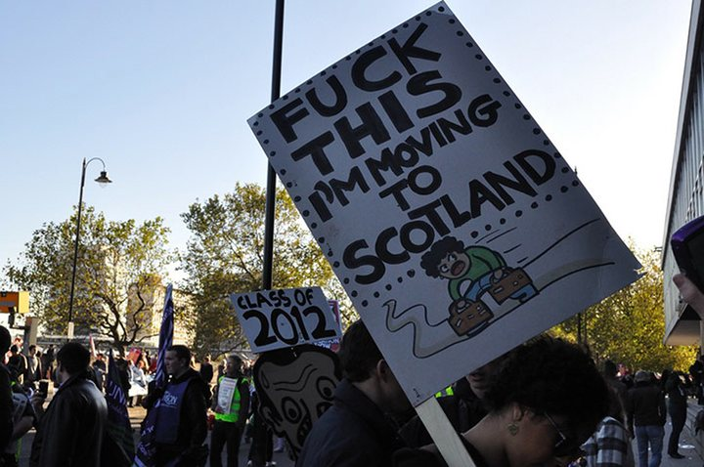

Slide 14
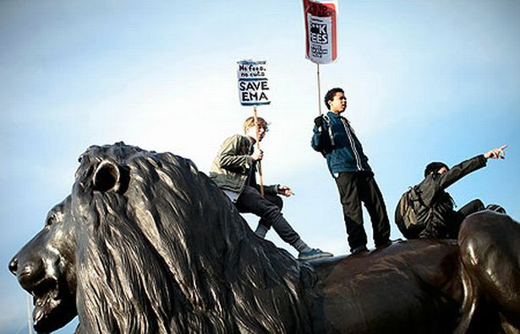

Slide 15
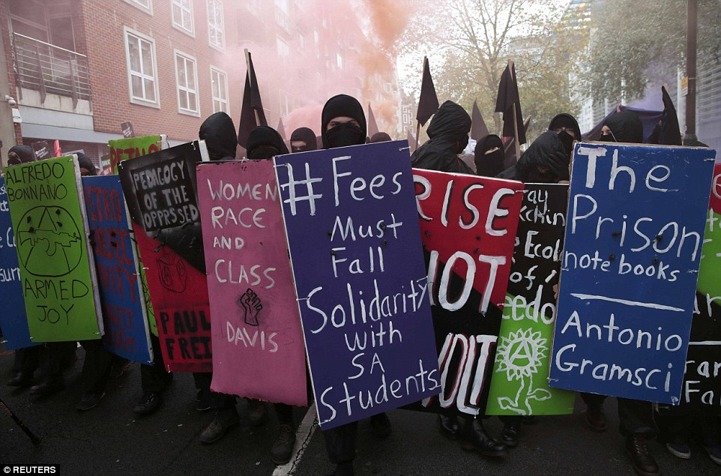

Slide 16
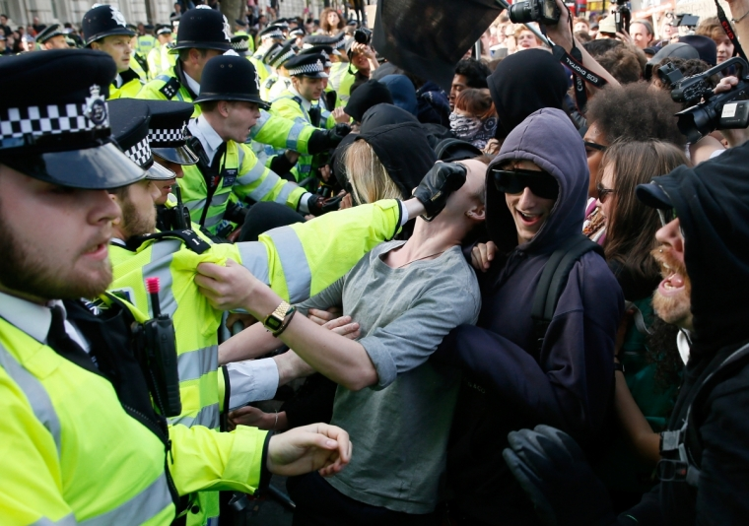

Slide 17
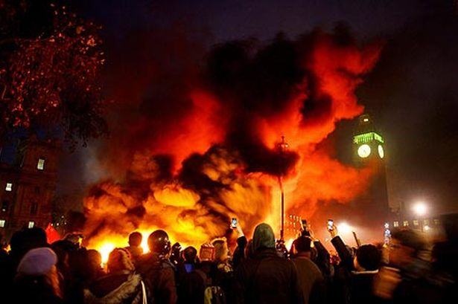

Slide 18
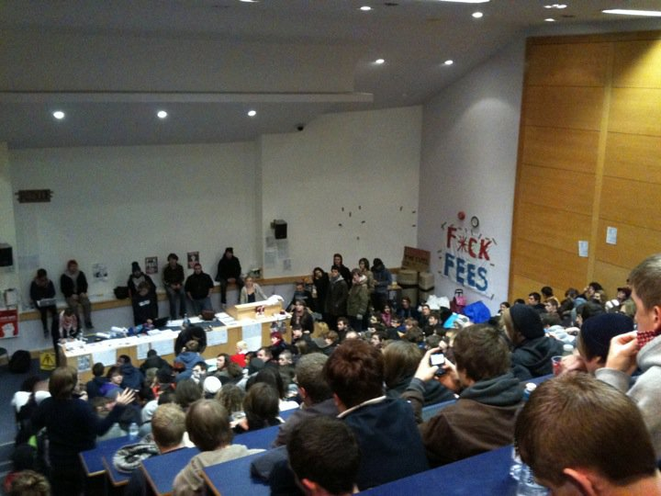
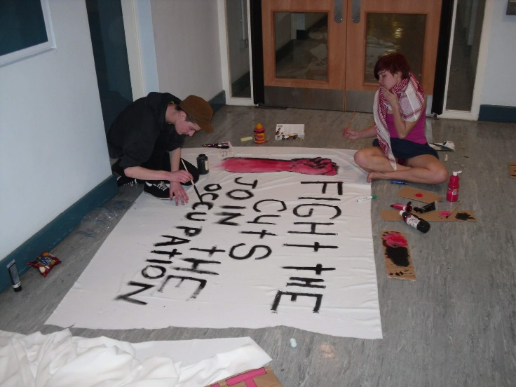

Slide 19
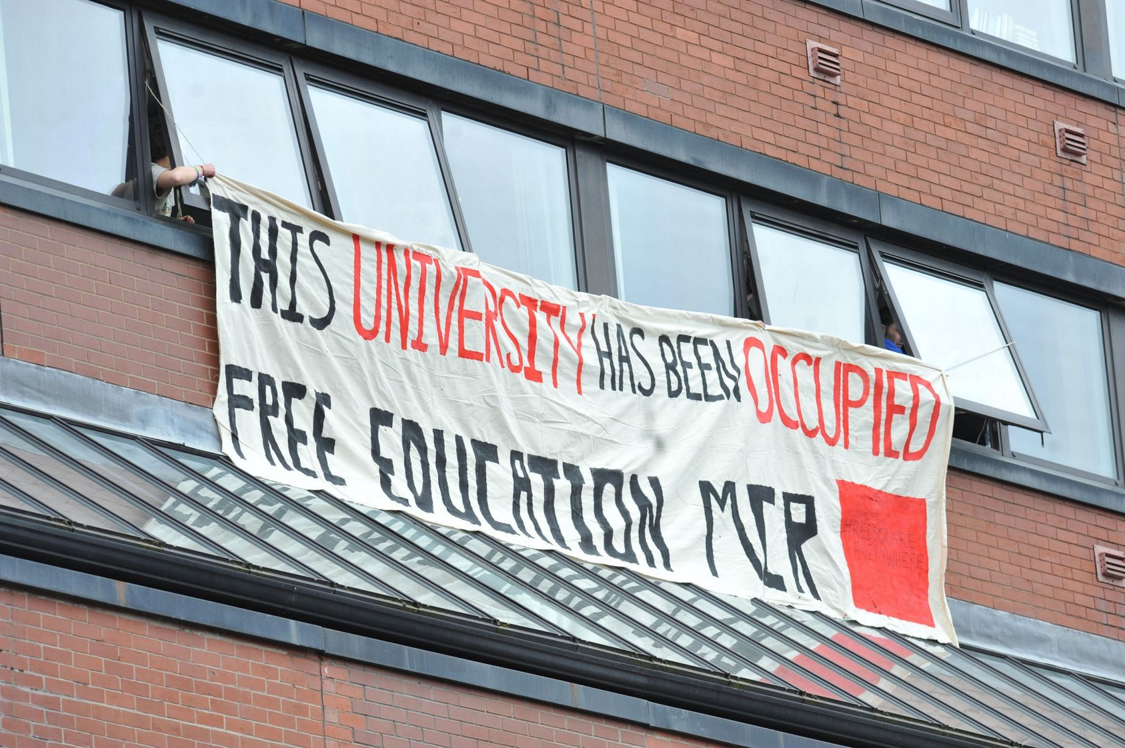

Slide 20
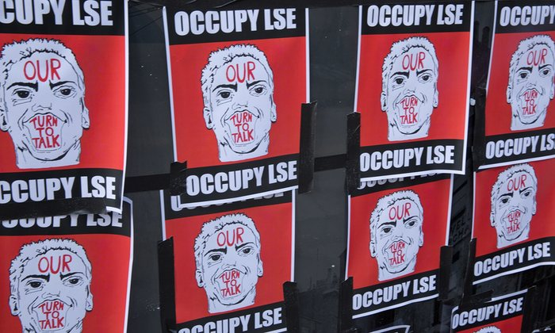

Slide 21
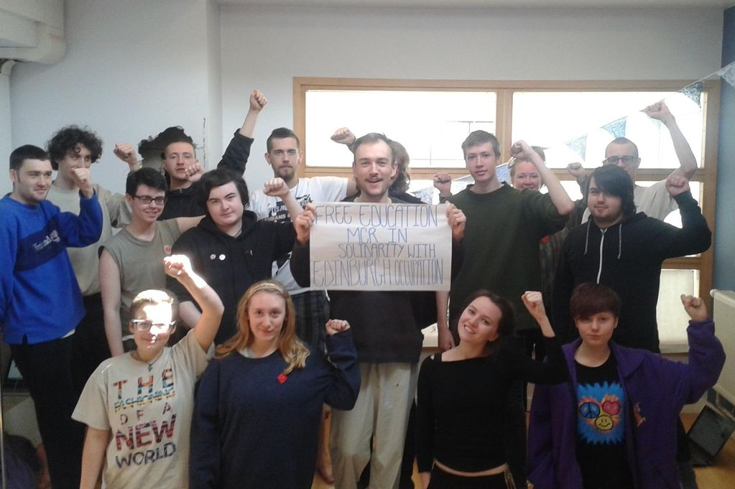

Slide 22
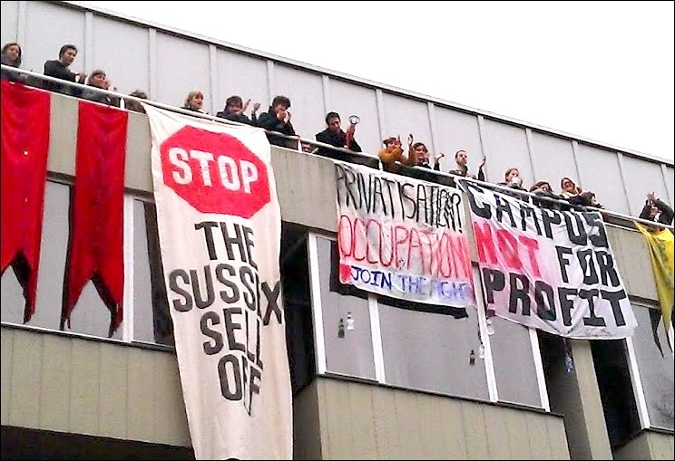

Slide 23
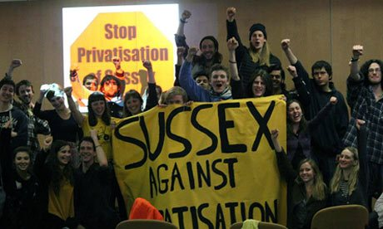

Slide 24
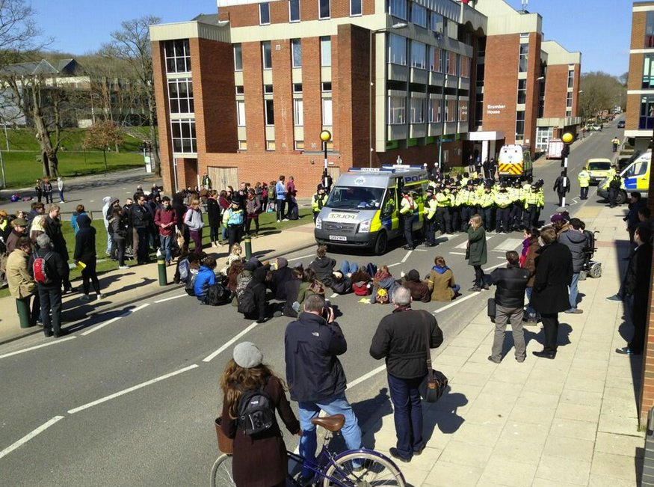

Slide 25


Slide 26
“interestingly, my generation…..are both young and old enough to have our feet in both camps: we understand the need to read Capital as well as the desire to put bricks through Starbucks’ windows; we forty-somethings understand the political purchase of sober critique and slightly mad destructive acts.”
(Merrifield, 2011: 4)

Slide 27
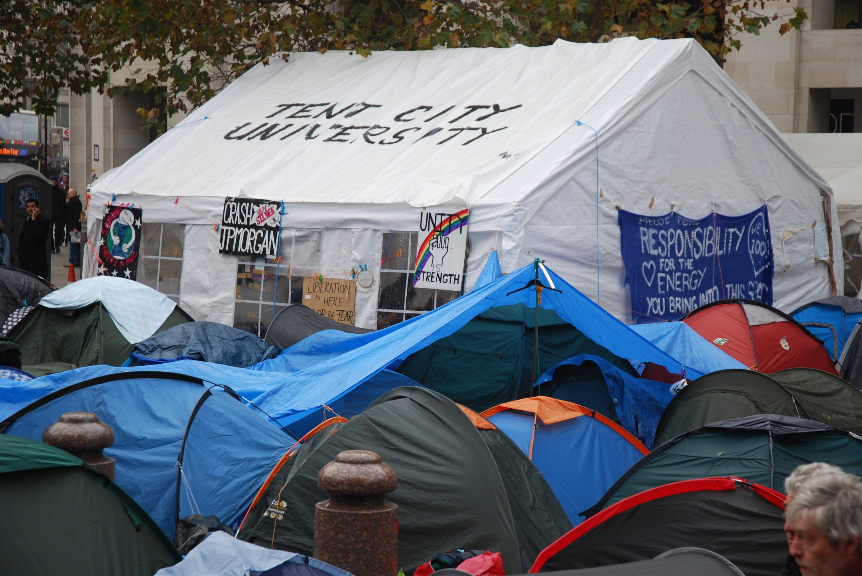
This Photo by Unknown Author is licensed under CC BY-SA

Slide 28
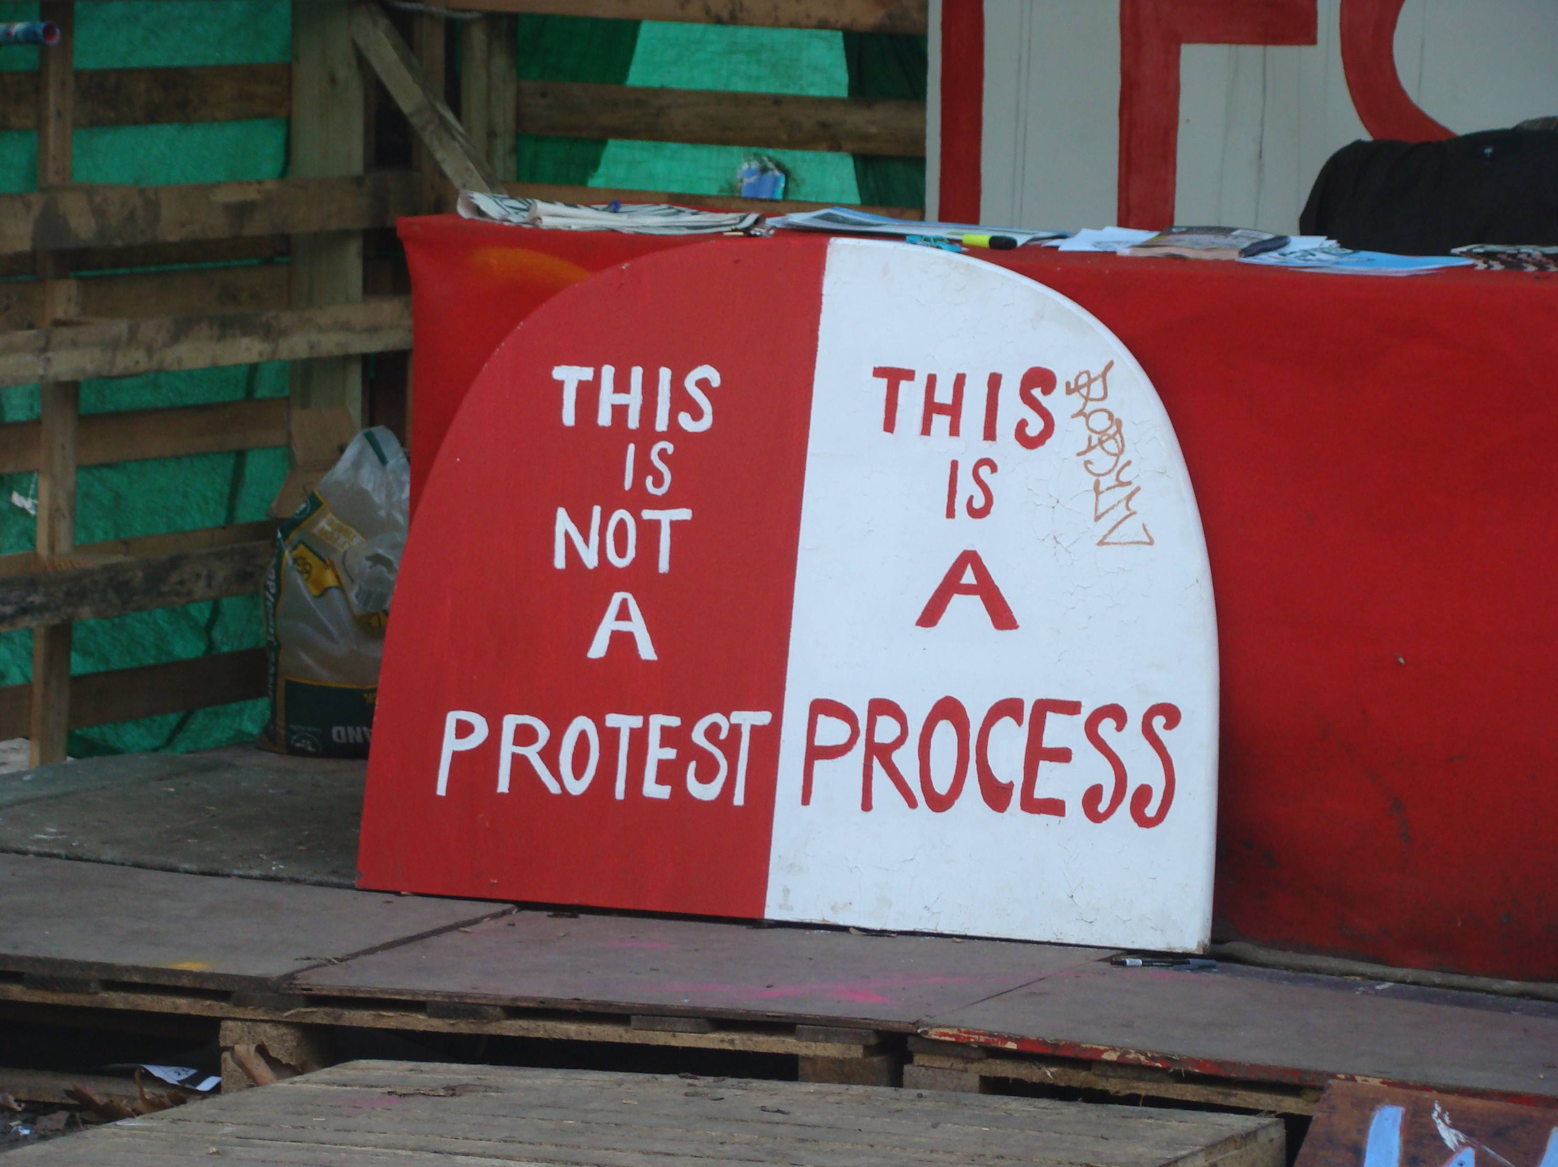

Slide 29
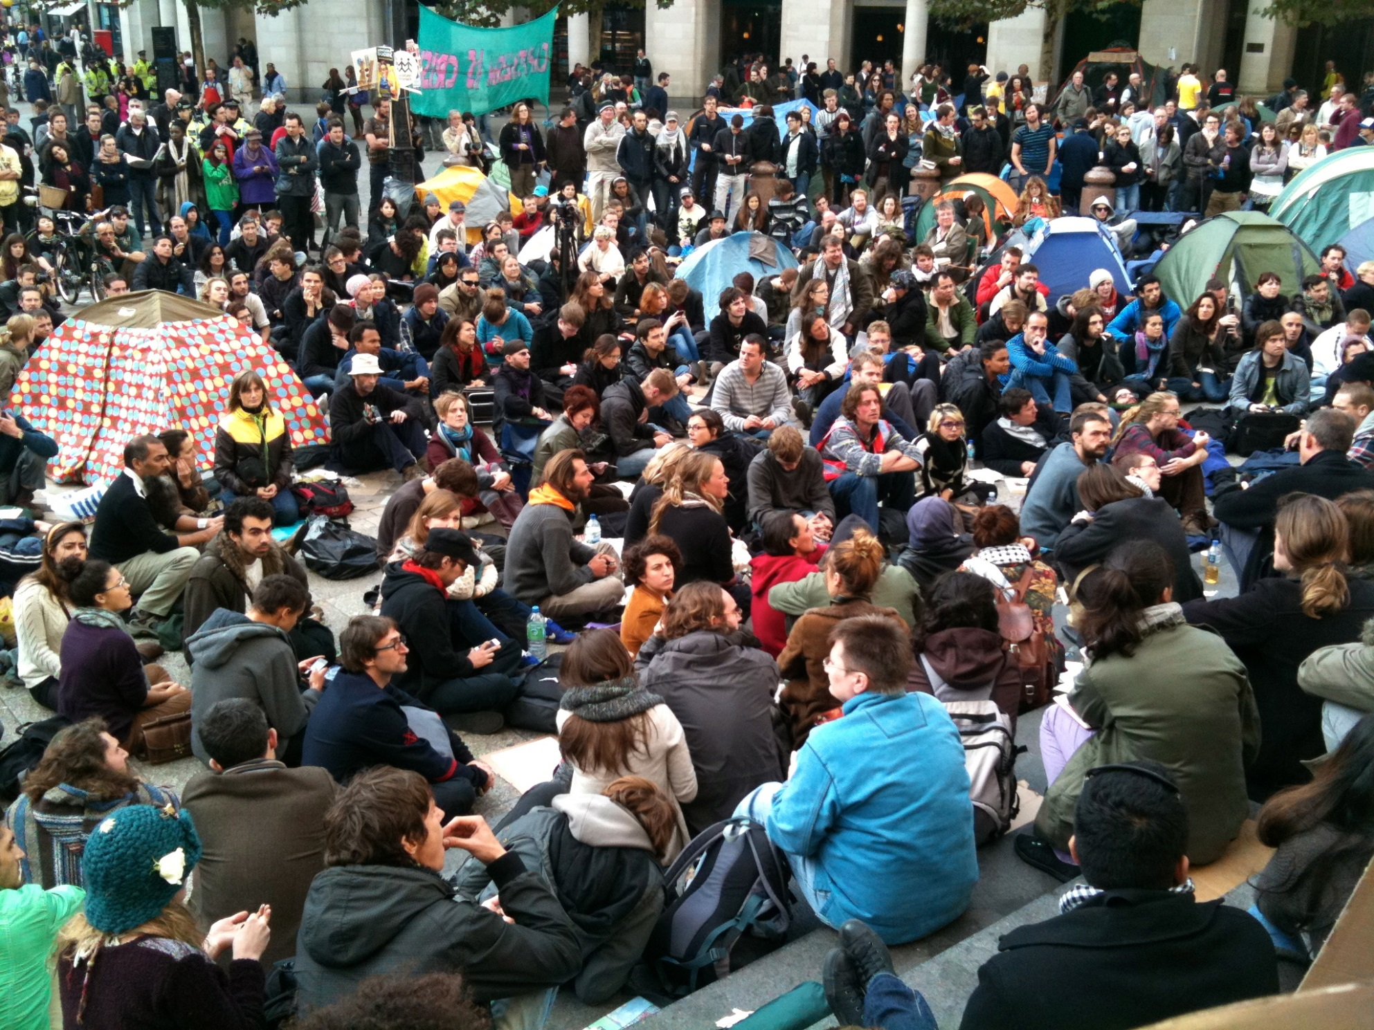
This Photo by Unknown Author is licensed under CC BY-NC-SA

Slide 30
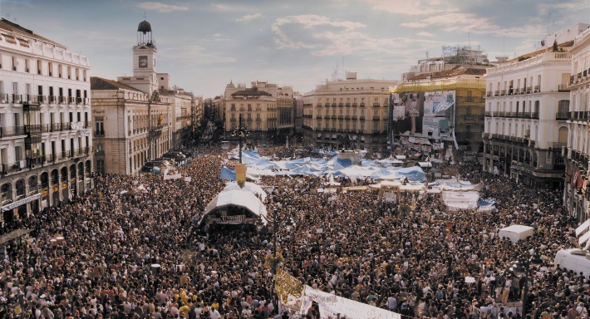
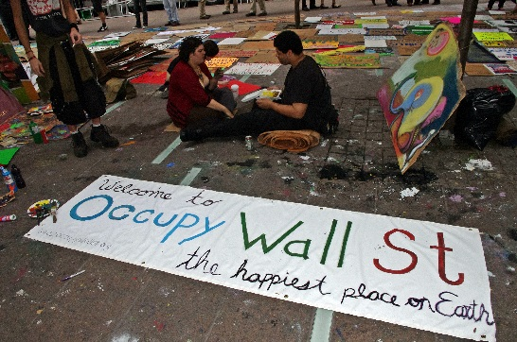
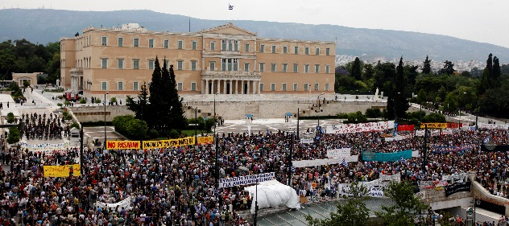
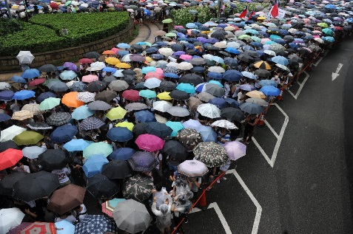
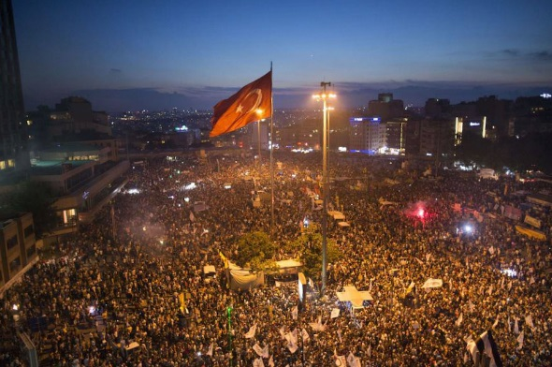
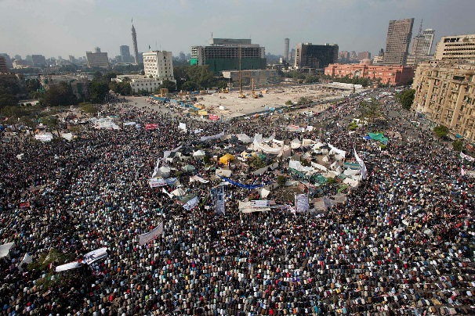
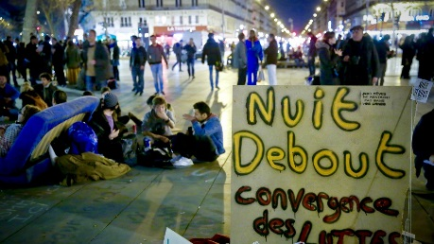
Internationally
M15 or Indignados, Madrid, Spain
Occupy Wall Street, NYC, USA
Occupy Central, Hong Kong (Umbrella Revolution)
Syntagma Sq, Athens, Greece
Taksim Square, Istanbul, Turkey
Nuit Debout, Paris, France
Tahrir Sq. Cairo, Egypt

Slide 31
“Our job is to help people become truly conscious, understand the different worlds we live in…..It is to teach people how to make up their own minds, and how to take control of their moment. It is to teach choice….Our job is to teach defiance”
(Newman, 2006: 10)

Slide 32
“the classroom remains the most radical space of possibility………
(hooks, 1994: 12)

Slide 33
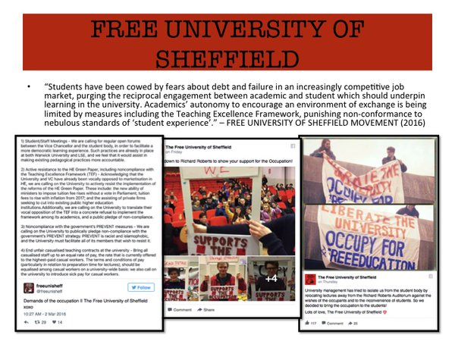

Slide 34
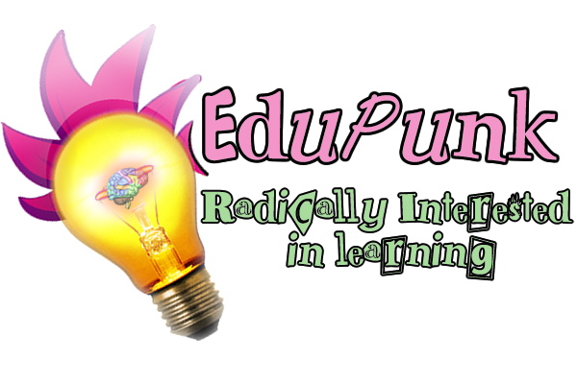

Slide 35
What does it mean to work in these spaces?
Finding a methodology that fits
Positionality – from both perspectives
Going native or critical distance?
Dealing with the hope, living with the despair

Slide 36
Finding a methodology that fits
Requirements of a methodology for these spaces
  Political framing – not to be ignored!
  Allows for insider criticality
  Does a ‘service’ to those in the research
  Allows for all aspects to be taken account of (cross/multi/inter/post-disciplinary)
  Compliments the complexity and fluidity of context
  Understands learning as not constricted to the usual spaces
  Encourages different ways of knowing

Slide 37
Bricolage
Developed from critical pedagogy and popular education, so fits with theoretical understandings
Allows for political framing of the work through researcher standpoint
Robust methodology with openness on methods – ‘methodological negotiator’ (Kincheloe & Berry, 2004)
Is a disposition (according to my PhD external examiner!)
Is a really cool way to conduct research!

Slide 38
Positionality
This is why it might be seen as a disposition…..
“the bricoleur is not aware of where the empirical ends and the philosophical begins, because such epistemological features are always embedded in one another” (Kincheloe & Berry, 2004: 15)
Working in solidarity with social movements (Kincheloe and Berry, 2004)or as ‘critical secretary’(Denzin, 2010)
Insider on the outside with critical distance – otherwise what use is the research?
Some social movements do not see it this way!

Slide 39
Example: The Occupy Research Collective Convergence
What is an insider?
What value does academic work have or how do you ‘pay’ for people’s time?
Where does the ‘power’ of knowledge come from?
  “your knowledge only has power because you say it does, if I don’t read it, it has no power”
Navigating ethics: Covenantal ethics (Brydon-Miller, 2009) or ethical rules? A controversial topic!

Slide 40
Example from the Occupy Research Collective
1. Anyone researching a social movement or activist group should, whenever possible, make those groups aware of the fact.
2. The researcher(s) should send examples of previous work and/or describe their political interests and motivations for researching.
3. If there are any concerns, the researcher(s) should make an effort to meet with the activist group to discuss further before continuing.
4. The researcher(s) should ask the activist group what research they consider useful and if possible collaborate on such endeavours.
5. More generally, the researcher(s) should, where at all possible, commit to some form of collaboration with the activist group, whether it be helping out at a protest camp (e.g. in the kitchen), a social centre, or on a demonstration, or through online work or more administrative tasks.
6. All research material should be made freely available for anyone to view.
7. Reasonable effort should be made to discuss research findings with activists groups before publication, in particular to try and avoid misrepresentations that could be politically damaging to the group.
8. Any ethical requirements imposed through external institutions should be made clear to activist groups in correspondence with them.
(guidelines available at http://piratepad.net/XqLMuhCau8)

Slide 41
Next project
Understanding how to link student movements with teaching and learning in Universities – another controversial topic!!
If knowledge can be thought of as becoming a movement – then can universities embrace this for the social good?
How much of our pedagogy can be political against a backdrop of metrics like the TEF and REF?
Can a classroom any longer be a ‘space of radical possibility’? (hooks, 1994)

Slide 42
Dealing with Hope, living with despair
The ‘predispotitional’ methodology of bricolage provides raw exposure to hope and despair
Occupy (and other spaces I have researched) were seductively hopeful but despairingly crushed
To believe the world can change is to have hope, to see efforts to do that dismantled and crushed is to feel despair
However, we persist because as Raymond Williams (1989) said:
“To be truly radical is to make hope possible, rather than despair convincing”

Slide 43
References
Edelman Boren M. (2001) Student Resistance: A History of the Unruly Subject, New York, London: Routledge.
Brydon-Miller M. (2009) Covenantal Ethics and Action Research: Exploring a common Foundation for Social Research. In: Mertens DM and Ginsburg PE (eds) The Handbook of Social Research Ethics. Los Angeles, London, New Delhi, Singapore, Washington DC: Sage, 243-259.
Denzin NK. (2010) The Qualitative Manifesto: A Call to Arms, Walnut Creek: Left Coast Press Inc.
hooks b. (1994) Teaching to Transgress: Education as the Practice of Freedom, New York, London: Routledge.
Kincheloe JL and Berry KS. (2004) Rigour and Complexity in Educational Research: Conceptualizing the Bricolage, Maidenhead, New York: Open University Press.
Merrifield A. (2011) Magical Marxism: Subversive Politics and the Imagination, London, New York: Pluto Press.
Newman M. (2006) Teaching Defiance: Stories and Strategies for Activist Educators, San Francisco: Jossey-Bass.
Williams R. (1989) Resourses of Hope: Culture, Democracy, Socialism London, New York: Verso.

